Slide 1
Architecture Extraction and Partial Parameters Extraction + Reconstruction
Black-Box-Attack Essentials
Amirmohammad Pournaghshband

Slide 2
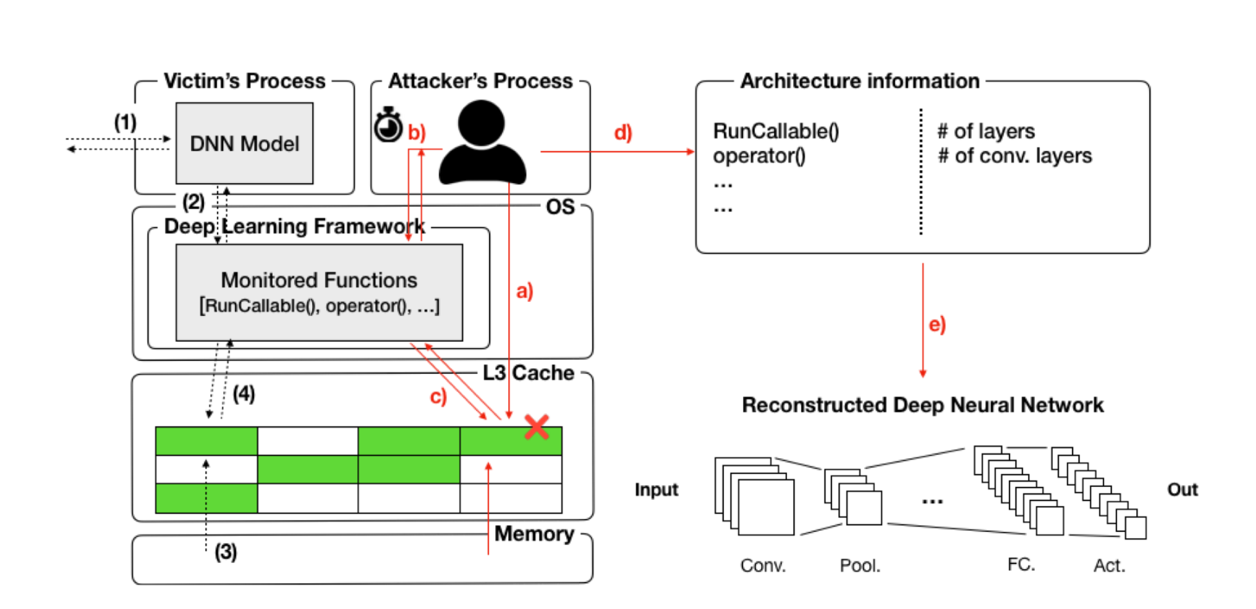
Architecture Extraction
Using “DeepRecon”
During forward/backward propagation, the victim DNN model computes the prediction using the functions in the DL framework
Since the attacker and victim share an instruction cache, the attacker can invalidate the cache lines that store the functions
Then monitor if the victim calls these functions by measuring the access time
Based on the mapping between the functions and the architecture attributes, the attacker reconstructs the architecture of the victim’s DNN

Slide 3
Architecture Extraction
Flush+Reload
The attacker and victim share the same DL framework library
Attacker flushes a cache line (clflush instruction)
The victim runs and may access that same memory location
Attacker reloads and times access:
Fast access → victim used it (it was in cache)
Slow access → victim did not use it.

Slide 4
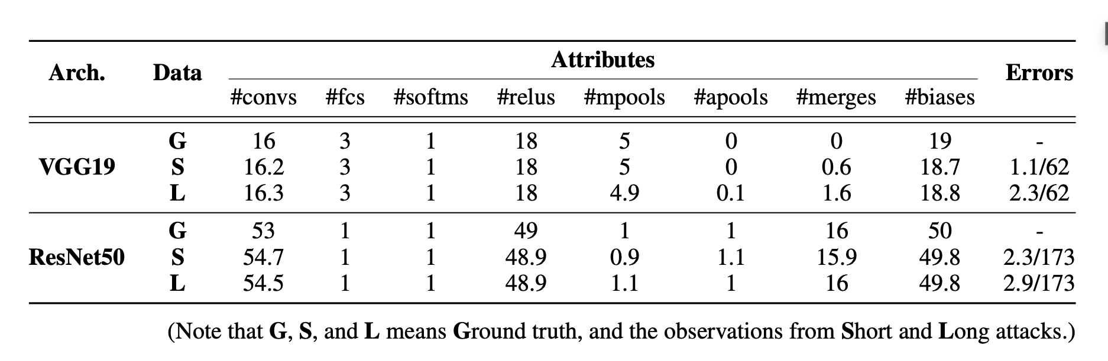
Architecture Extraction
Short attack: They repeat this with 10 random queries and report the average. This simulates a scenario where the spy process can only “peek” occasionally.
Long attack: The attacker stays co-located and observes the victim for a longer, continuous period — e.g., 10 queries in a row.

Slide 5
Architecture Extraction
Challenges
The OS and software versions being used in the attack are outdated:
Ubuntu 16.04
Python 2.7.15-rc1
TensorFlow 1.10.0
Mastik v0.0.2
We must use two different users on the same VM (CPU architecture problem!) or cluster
Possible Solutions:
To continue with this outdated method (particularly since our paper is not focused on this topic)
We can consider studying newer papers, such as DeepCache-2024.

Slide 6
Partial Parameter Extraction
Using DeepSteal
HammerLeak
Uses rowhammer as a side-channel attack
Improved leakage vs. classic RAMBleed
Con: We use the rowhammer attack at least once before the bit-flip attack

Slide 7
Reconstruction
Mean Clustering Training
Mean Clustering Training:
Fully recovered weights → freeze them (no training needed)
Partially recovered weights → train them, but penalize them to stay near the leaked range
No info at all → train normally, no extra constraints

Slide 8
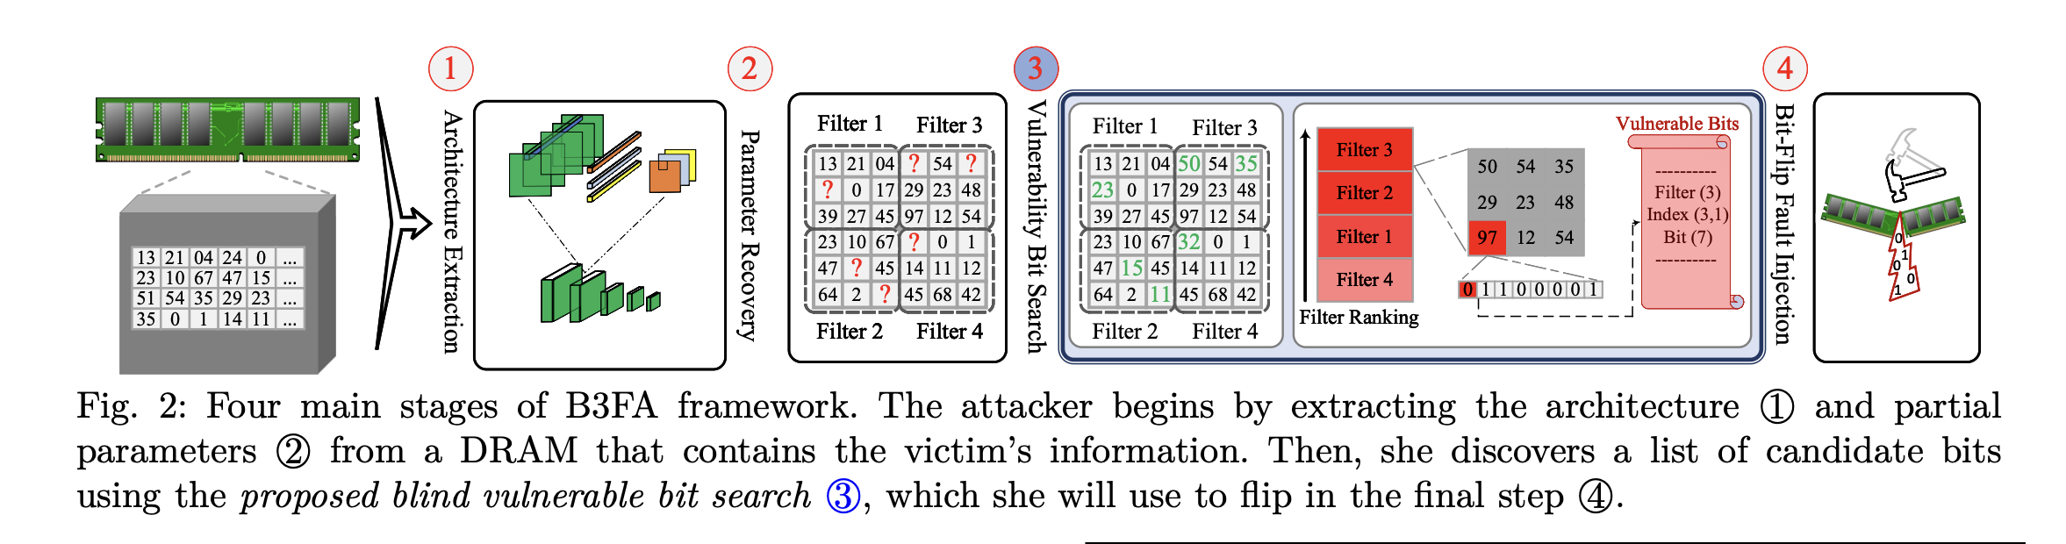
Reconstruction
CZR
CZR (Closer to Zero Reconstruction)
A method to estimate missing weight bits in partially recovered models.
Based on the observation that most DNN weights are close to zero.
Predicts unknown bits to make weights as small (close to zero) as possible.
Improves the reliability of FL2R when full parameter values aren’t available.

Slide 9
Reconstruction
CZR
This means that the smallest positive number is 0 or 00000000
The biggest negative number is -1 or 11111111
The parameters with the recovered sign bit of 0 (a positive weight)
For a positive parameter, all of the unextracted bits in that parameter will be set to zero
The parameters with the recovered sign bit of 1 (a negative weight)
For a negative parameter, all unknown bits will be set to one
The parameters with an unrecovered sign bit:
We consider the sign bit once positive and once negative, and reconstruct the other unknown bits
We consider the one with the lower absolute value as the reconstructed parameter

